Slide 1
XERO Application (Team 2)
TEAM 2 (SPRING 2025)
ANITHA RAJ BALE (QA MANAGER)
DEEPAK RAJ REDDY KODUR (TESTER)
HARSHIL (TESTER)
MOLDIR (QA ANALYST)
RAHUL (BUSINESS ANALYST)

Slide 2
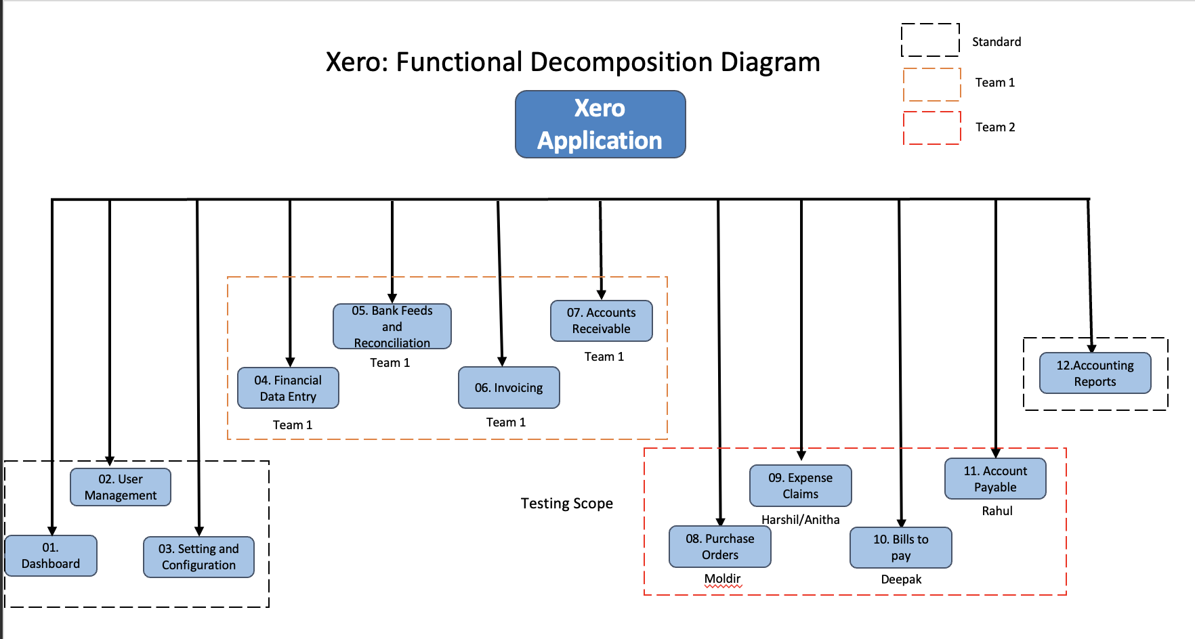
Functional Decomposition Diagram (Presented by Anitha Raj Bale)

Slide 3
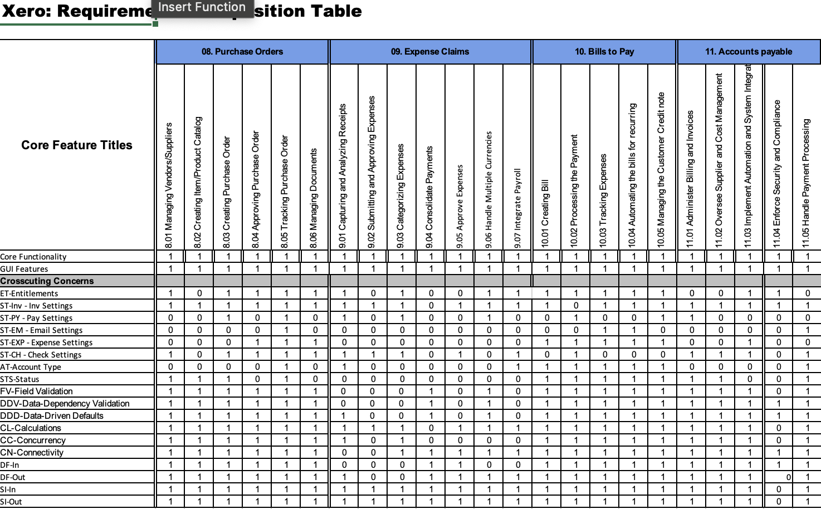
Requirements Composition Table (Presented by Moldir)

Slide 4
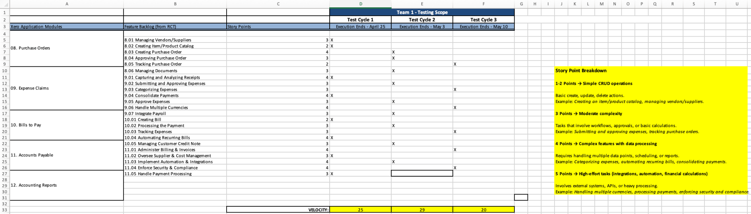
Testing Roadmap (Presented by Deepak Raj Reddy Kodur)

Slide 5
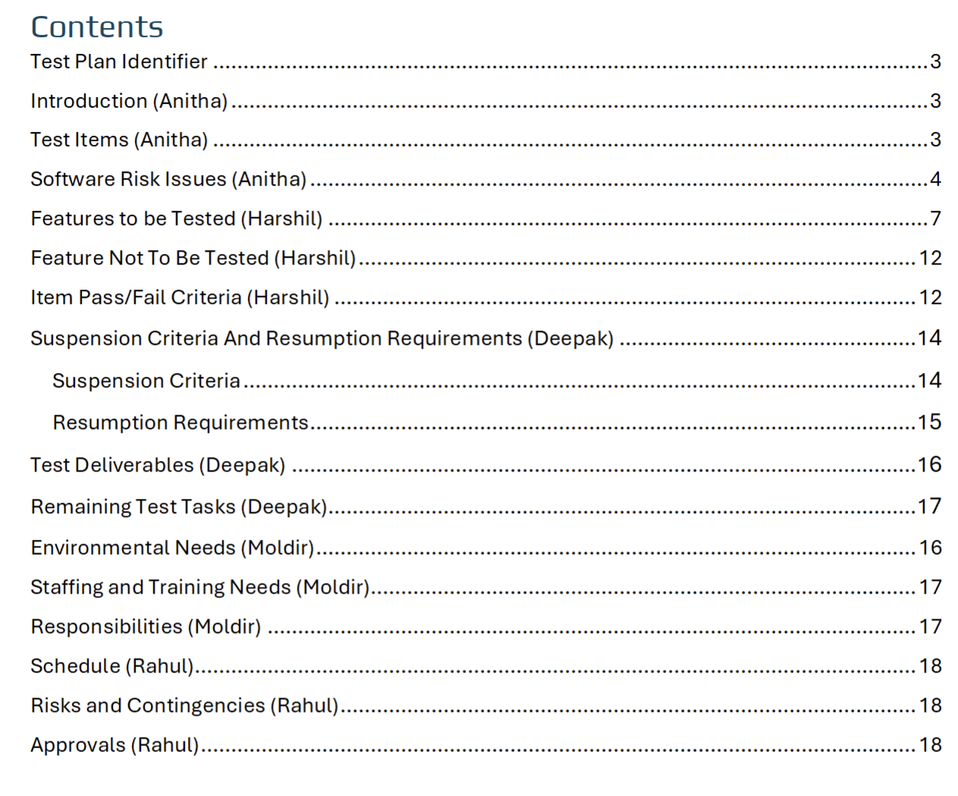
Test Plan (Presented by Deepak Raj Reddy Kodur)
Testing Scope
Testing Objectives
Test Process Definition
Approach to System Testing

Slide 6
Test Plan (Presented by Deepak Raj Reddy Koduru)
Entry/Exit Criteria
Entry Criteria - Xero demo environment set up with required data (vendors, products, currencies)
Test cases for modules 08–11 created and approved
Access to tools (qTest, JIRA) and stable 3rd-party APIs
Exit Criteria - All planned test cases executed ,No critical/blocker defects in core workflows , UAT sign-off and updated traceability matrix
Environmental Needs
Platform: Xero Demo company
Test Data : 50+ invoices, 30+ bills, 100+ bank transactions, multi-currency (USD, EUR, GBP)
Tools : qtest,JIRA ,Stripe/Paypal Sandbox
Roles and Responsibilities
QA Manager: Approves plans, oversees risks, and test cycles
QA Analyst: Designs/executes test cases, logs/retakes defects
Business Analyst: Aligns tests with accounting rules and workflows
Software Tester: Executes tests and logs defects with evidence
Jira/qTest Admin: Executes tests and logs defects with evidence

Slide 7
Test Plan (Presented by Deepak Raj Reddy Kodur)
Test Cycles and Schedules
System testing includes three cycles:
Cycle 1: Vendor & PO flow (Modules 8.01–8.05) - (Apr 18–25)
Cycle 2: Expenses, billing, payments (Modules 9.01–10.05) - (Apr 26–May 02)
Cycle 3: Automation, high-effort tasks (Modules 11.01–11.05)- (May 03–09)
Risks and Contingencies
Risks - CRUD operation failures in core modules (POs, ECs)
Payment gateway downtimes (Stripe/PayPal)
Security misconfigurations in approval workflows
Integration issues with payroll or bank feeds
Contingencies - Reallocate resources and extend cycles
Use sandbox/payment fallback methods
Early API testing and strict role validation
Manual CSV imports to simulate bank feeds

Slide 8
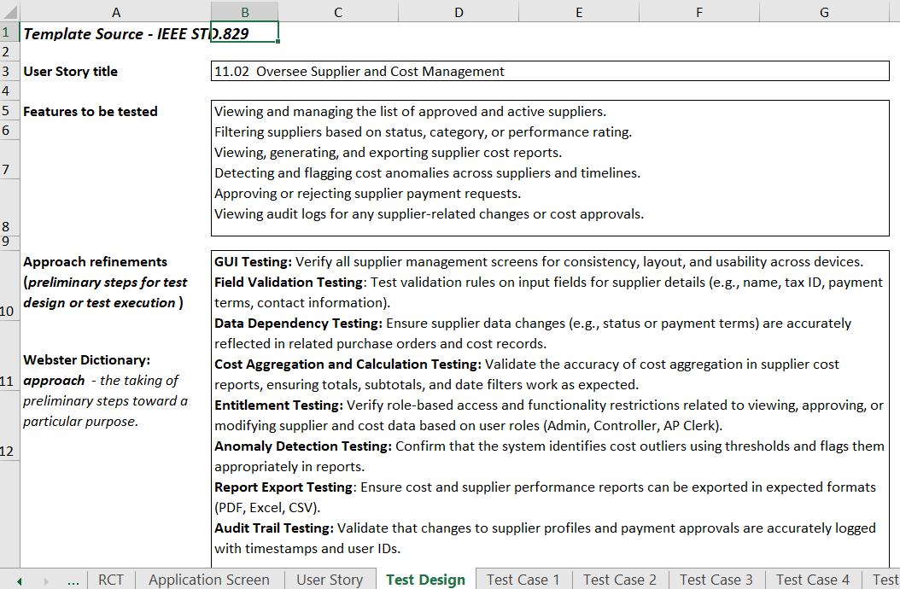
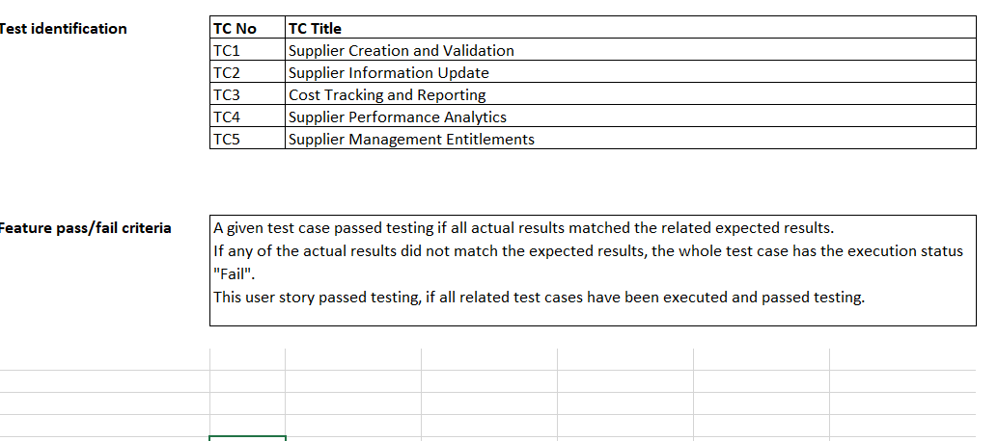
Test Design Specification (Presented by Rahul)

Slide 9
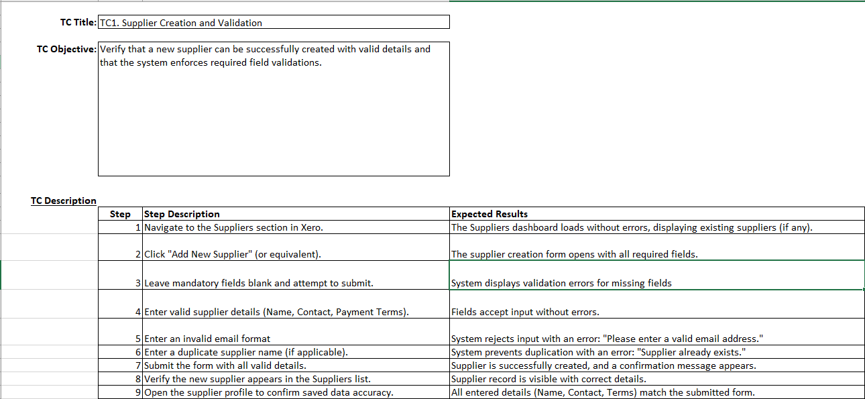
Test Case Specification (Presented by Rahul)

Slide 10
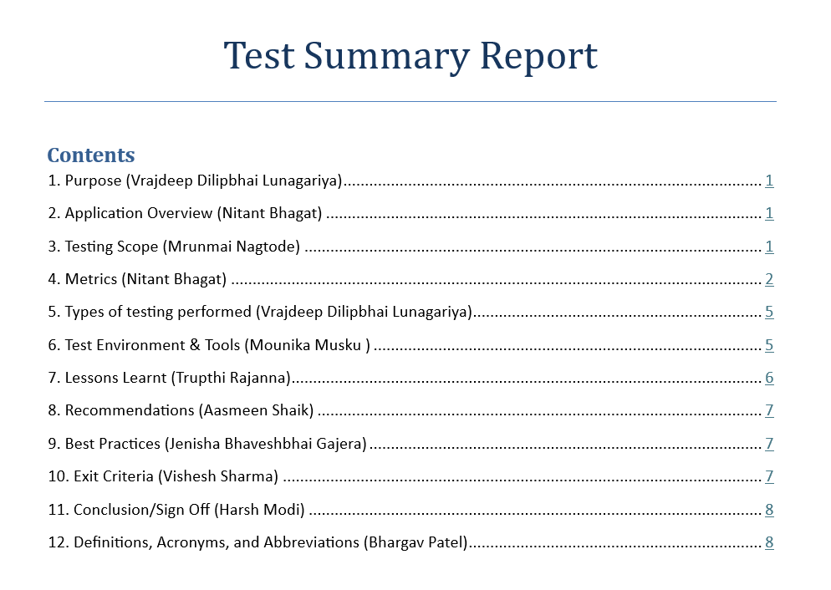
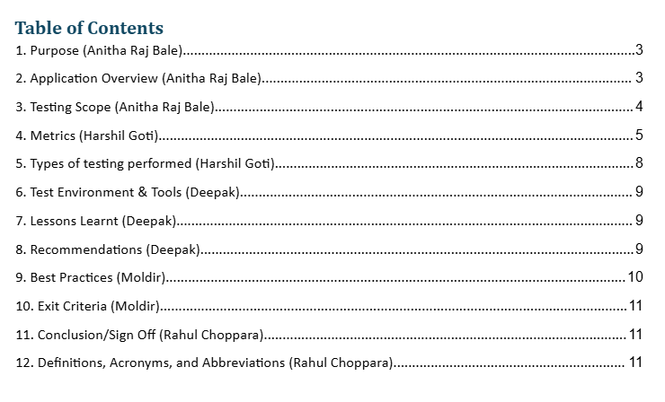
Test Summary Report (Presenter - Harshil Goti)

Slide 11
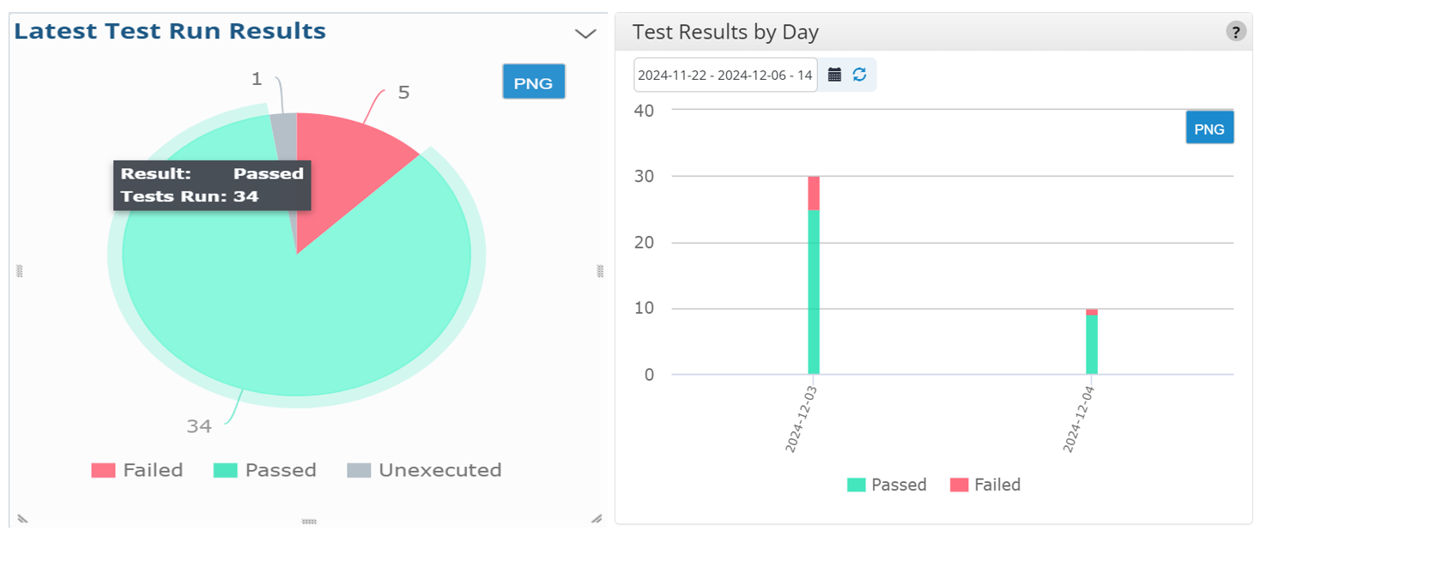
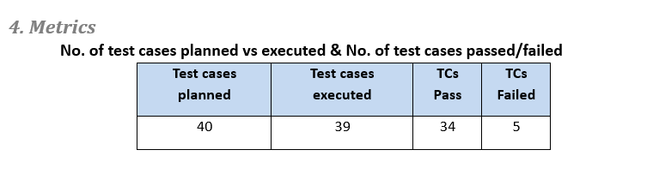
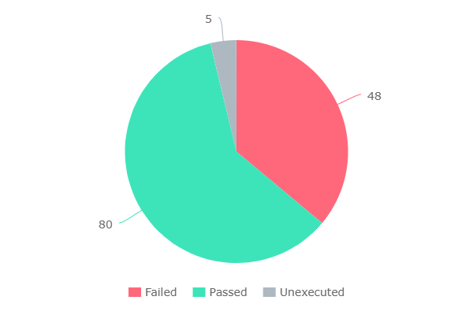
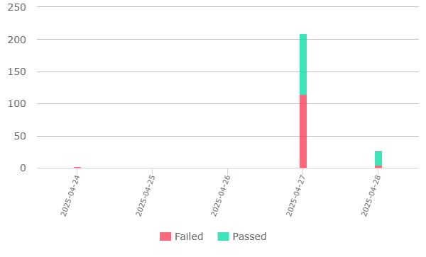
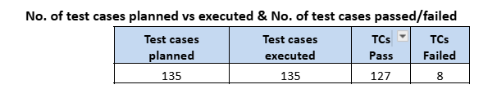
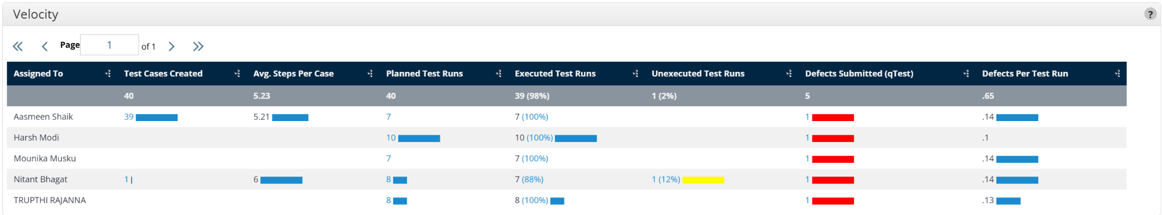
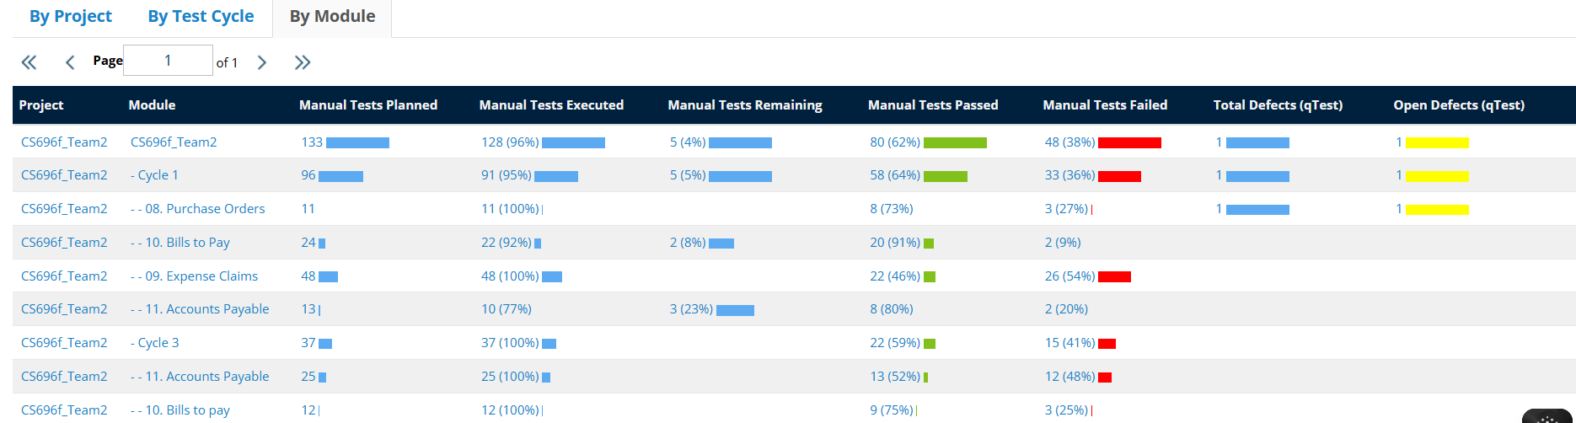
Test Summary Report (Presenter Harshil Goti)

Slide 12
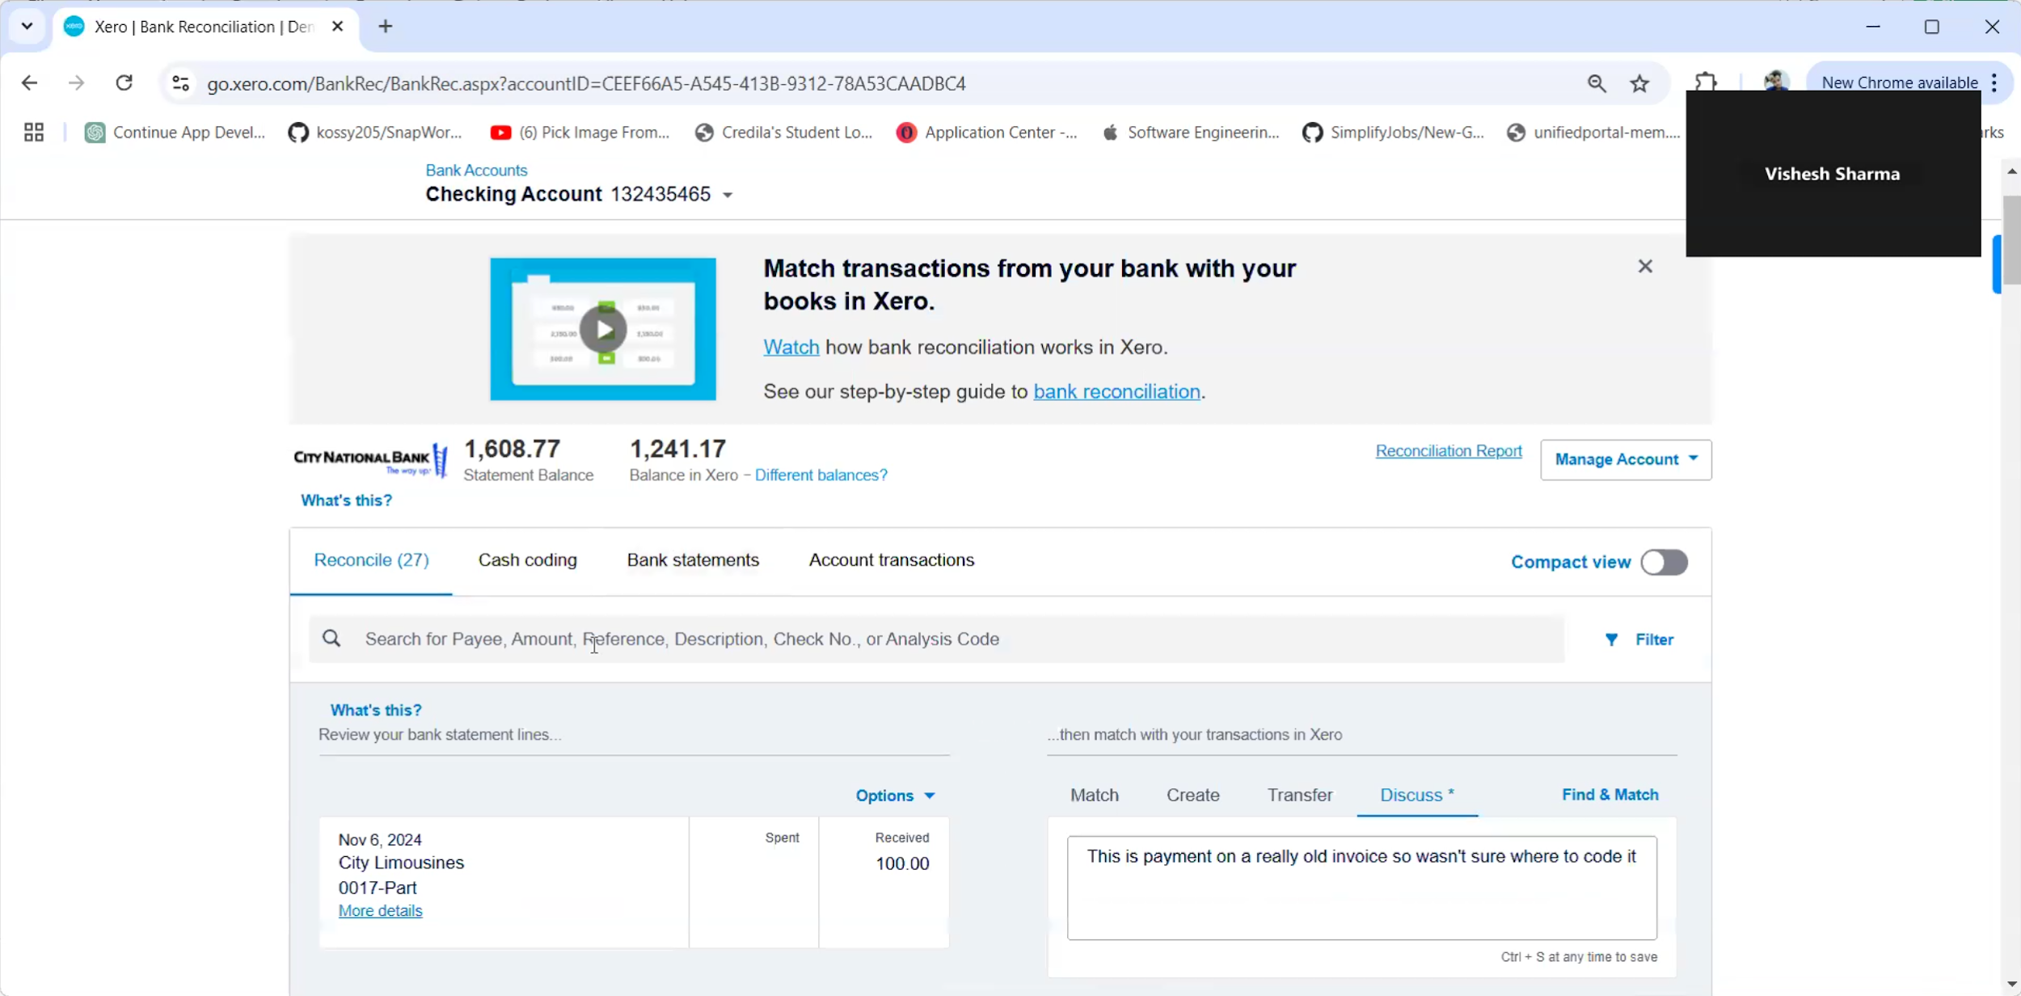
Application Recorded Demo (Presented Moldir)

Slide 13
Appendix:
GitHub Repository

Slide 14

GitHub Repo Link
htthttps://github.com/Anitharaj31/Team2https://github.com/Anitharaj31/Team2
https://github.com/Anitharaj31/Team2

Slide 15
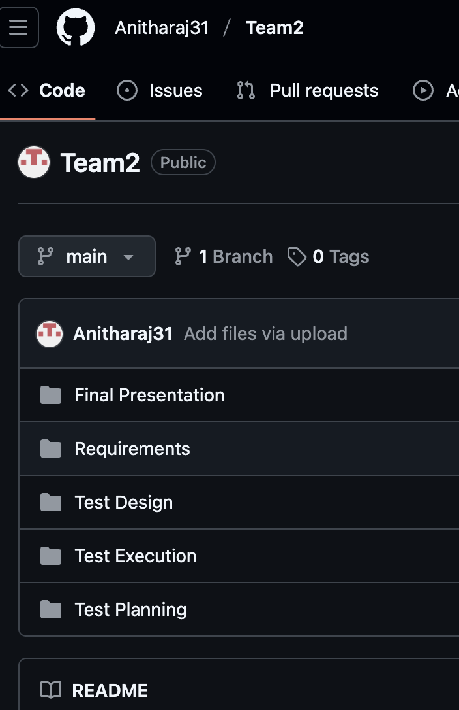
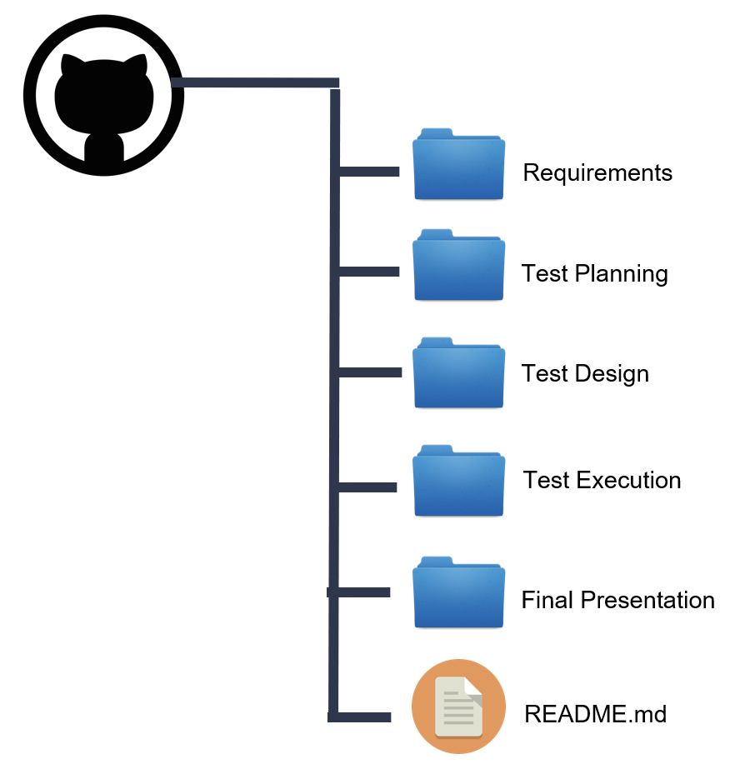
GitHub Folder Structure

Slide 16
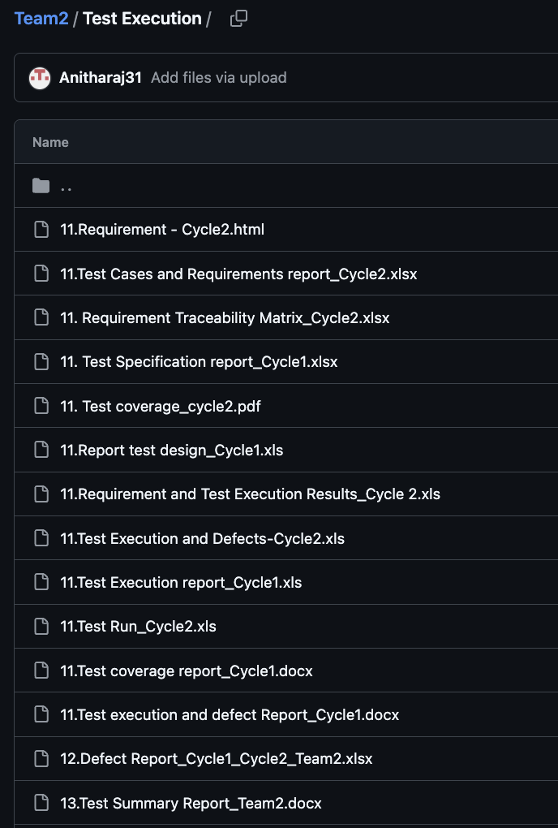
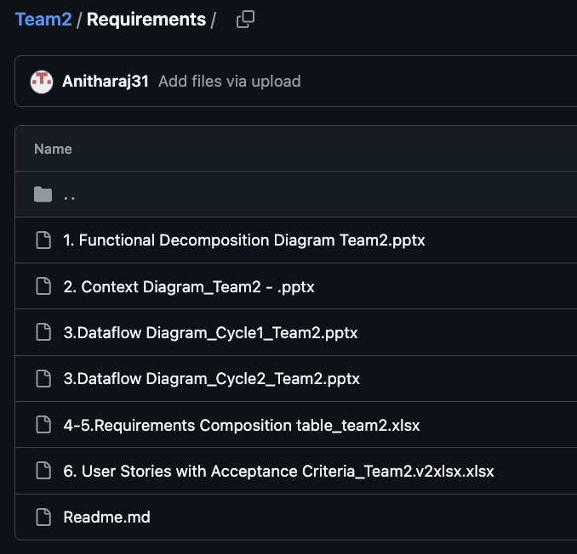
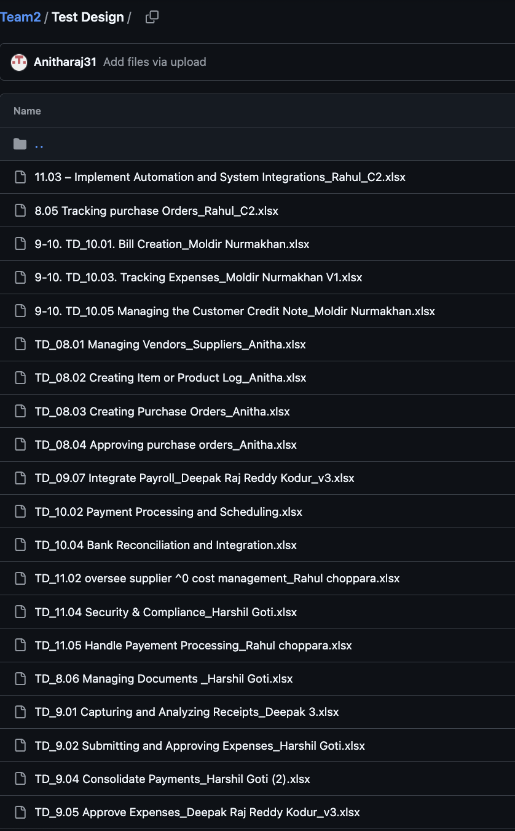
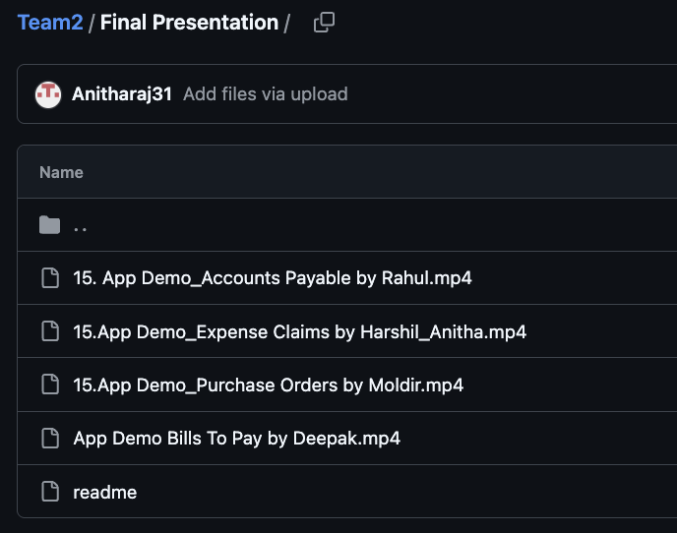
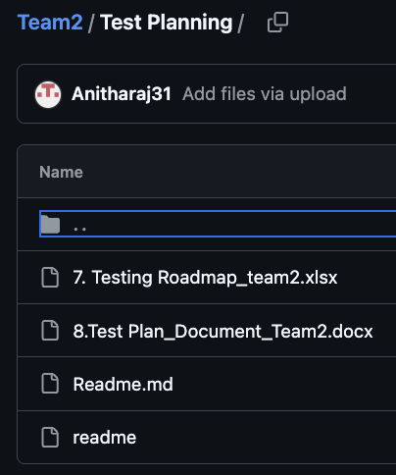
GitHub Folder Structure

Slide 17
THANKYOU

